Slide 1
Bleeding segmentation of surgical images
Tian Zhao
Technical University Dresden
Faculty of Computer Science
Dresden, Germany
Notes:
Hallo
Tian Zhao
Uni, Faculty
Title
------------------------------------------------
First of all, ill give you a introduction of my project.

Slide 2
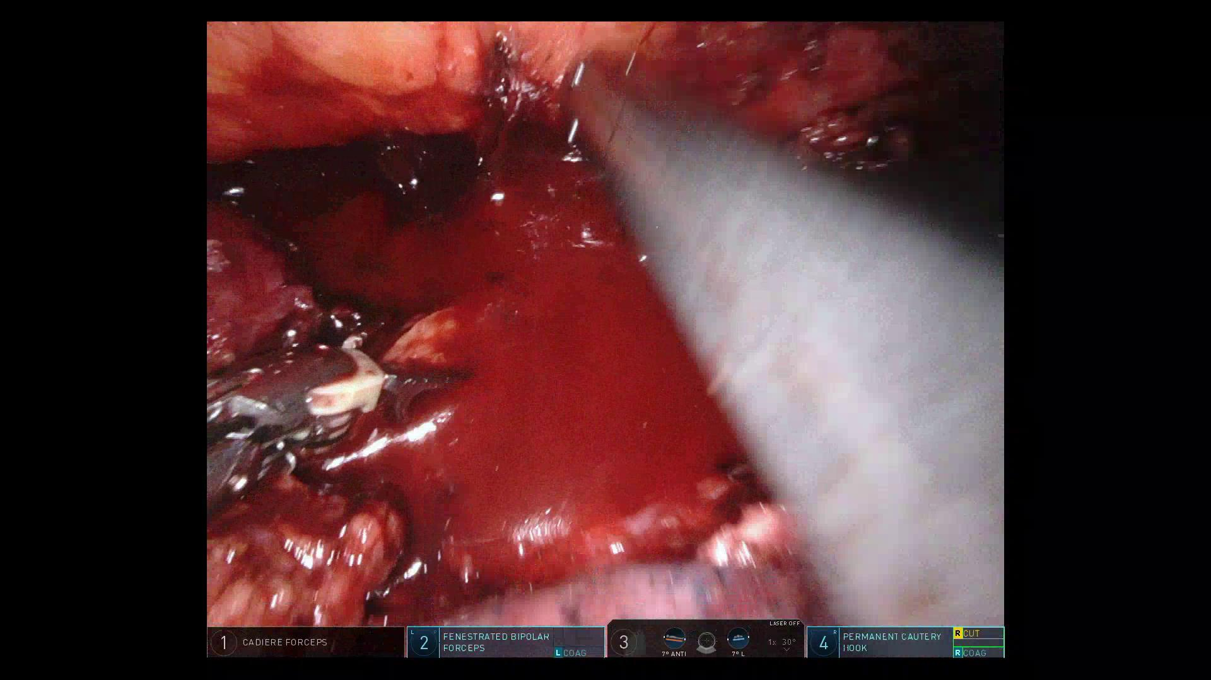
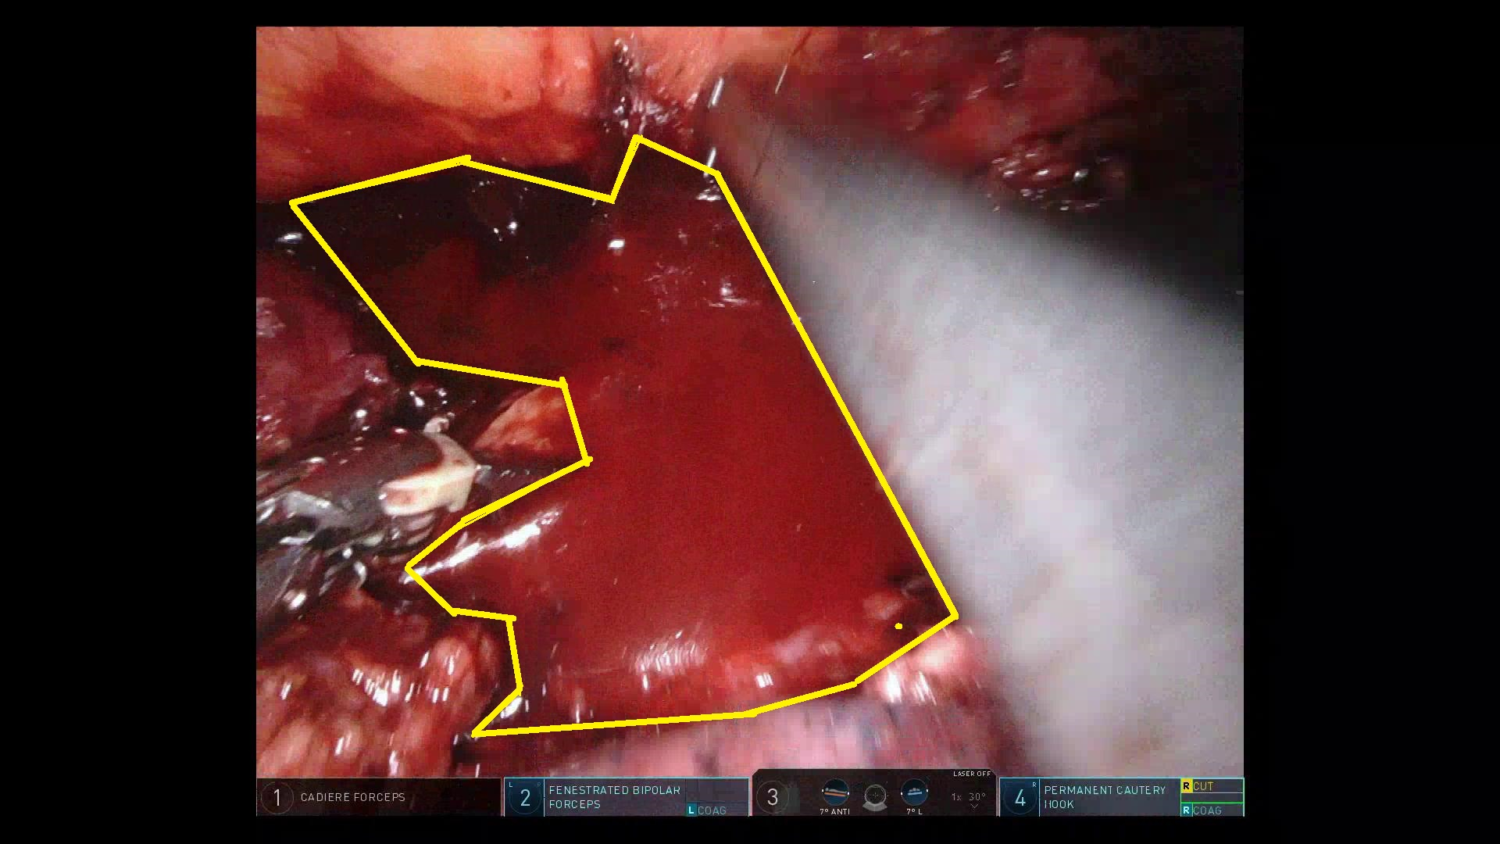
Project introduction
Main purpose
CNN-models:
UNet
Multi-Output UNet
FCN_ResNet
DeepLabV3_ResNet
Fig 1. Segmentation process
Evaluation methods
  dice loss, precision, recall, specificity, f₁
Notes:
The basic process is shown in figure 1
Purpose:
Create a program for surgical assistance.
Which can show the bleeding area during surgery.
Structure:
Input go through model, then the bleeding area should be markd on output image.
Models: ….
Evaluation:
-------------------------------------------------------------------------
First step of my project is to create a dataset from surgical videos and annotation data.

Slide 3
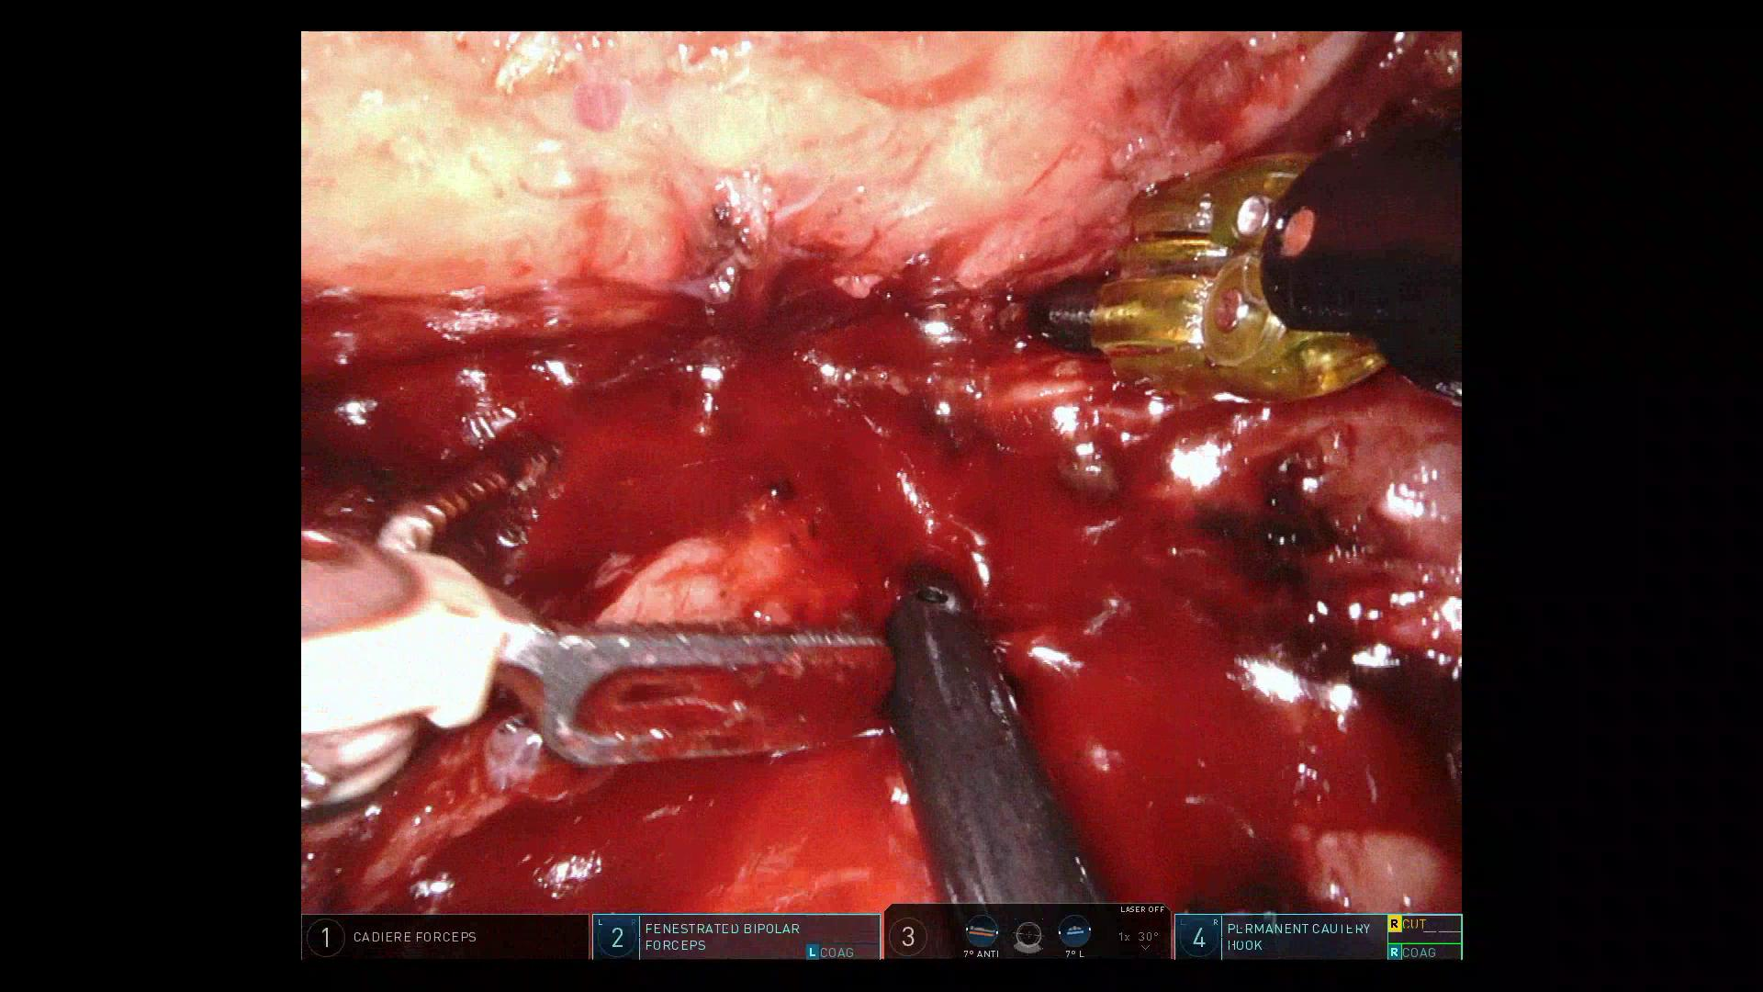
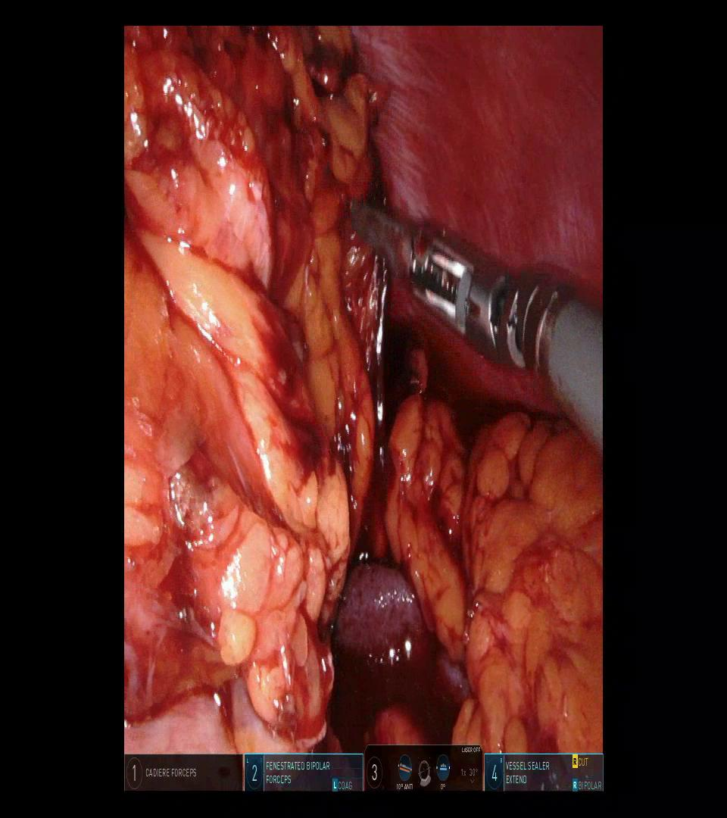



Dataset
Origional images
Fig 2. original surgical images
Polygon annotations
In form of: [(x₀,y₀), (x₁,y₁), … (x_{n},y_{n})]
Generated masks
Fig 3. generated masks
Notes:
Frames of those surgical videos are shown in figure 2.
In the frames, there will be organs, surgical tools and maybe bleeding area.
On the edge of those images there will also be some additional info, such as those tabs at bottom.
The annotated areas are saved as a lists of positions in a excel table. Each list represents a Polygon area.
The masks, which is generated from annotation data are shown in fig.3.
Will be treated as ground truth, will be used to evaluate the segmentation result.

Slide 4
Dataset
Size
  Number of surgeries: 9
  Number of images WITH bleeding: 946 (70%)
  Number of images WITHOUT bleeding: 405 (30%)
K-Ford validation (k=5) grouping rules
  Absolutely separated training and evaluation sets
  Minimum difference between size of groups
Validation group size
  [250, 250, 250, 250, 250]
Notes:
The surgical videos are from 9 surgeries and 946 annotated images from those videos.
Beside of images containing bleeding, images without bleeding are also needed.
To represent the real situation and considering the training time, 405 images without bleeding area are added.
To make a better evaluation of models, K-ford validation was used. Data are seperated into 5 groups following 2 rules:

Slide 5
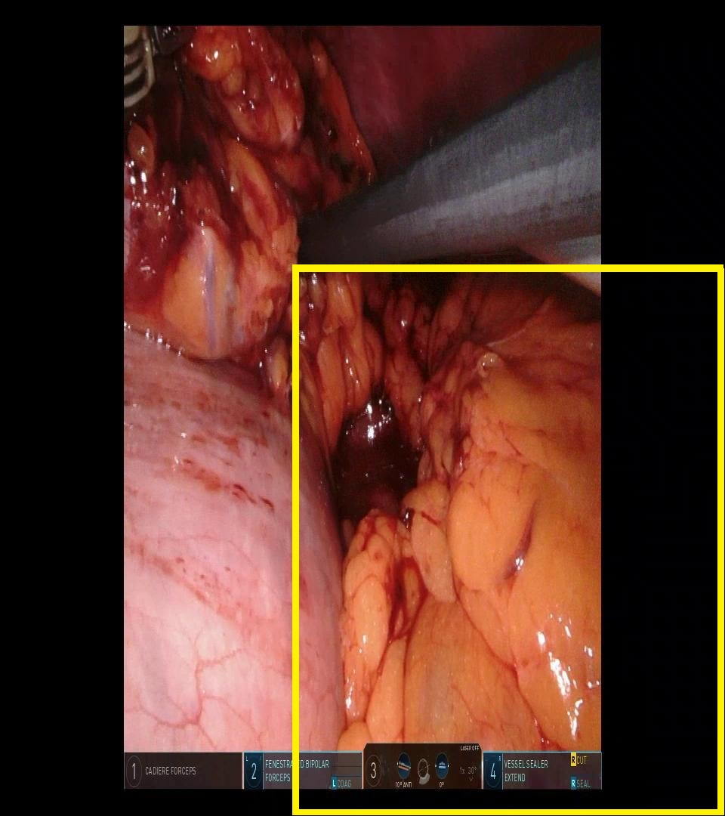
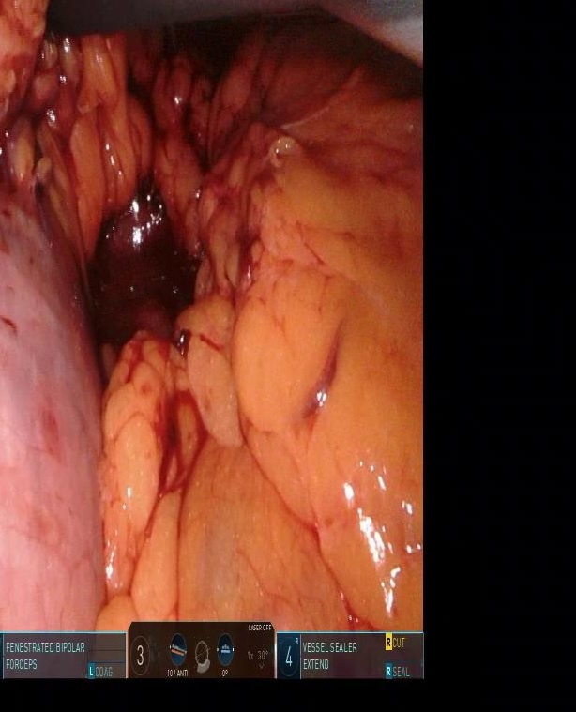
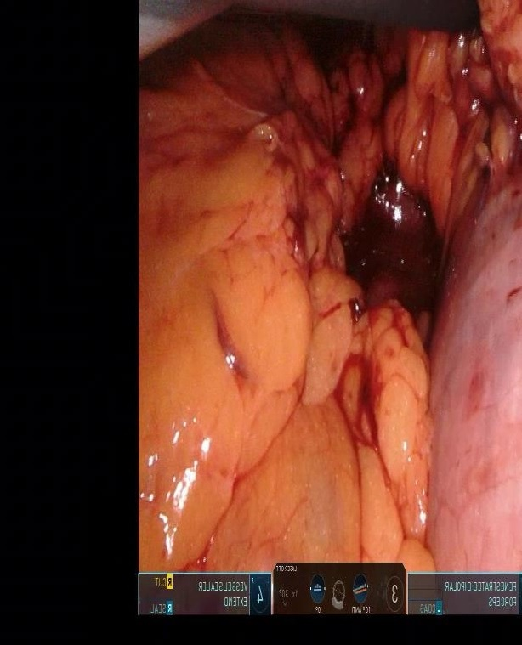
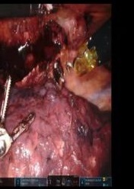
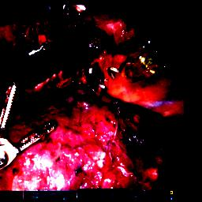
Pre-Process
Random-crop and flip (all models)
Fig 4. random crop
Fig 5. random flip
RandomResizedCrop((256, 256), scale=(0.5, 1.0))
RandomHorizontalFlip()
Normalisation (ResNet only)
Fig 6. normalization
Normalize( mean = [0.485, 0.456, 0.406],
std = [0.229, 0.224, 0.225] )

Slide 6
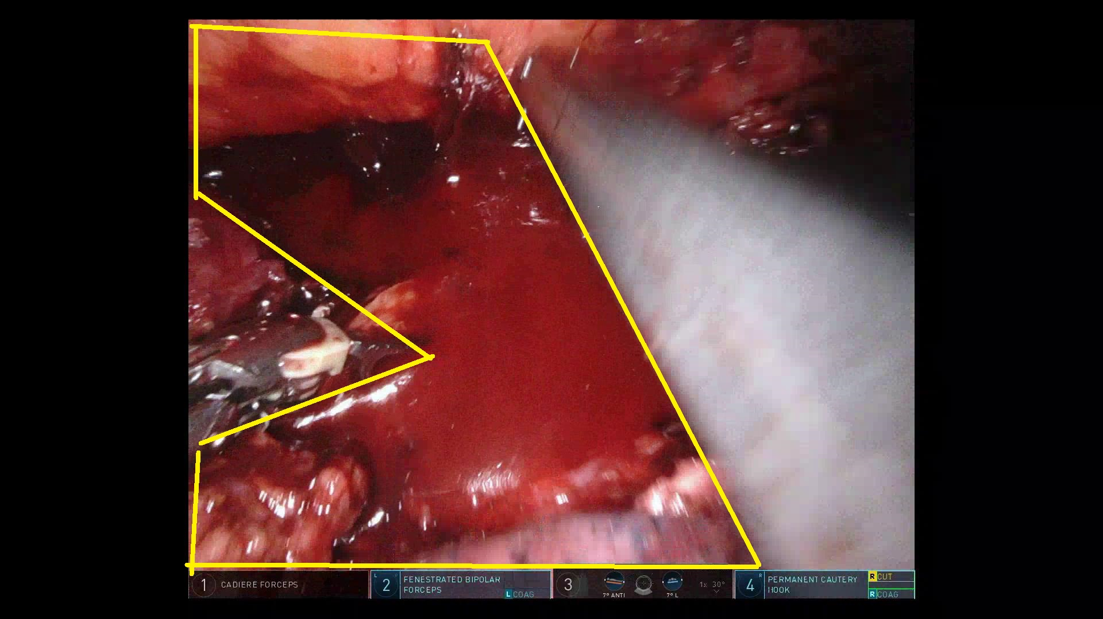

Evaluation methods
Dice loss
•
•
Positiv(I_{e}) ↑
DiceLoss(I_{m}, I_{e}) ↑
too large
Positiv(I_{e}) ↓
TP(I_{m}, I_{e}) ↓↓
DiceLoss(I_{m}, I_{e}) ↑
ground truth
Fig 7. estimation group
too small

Slide 7
Evaluation methods
Confusion matrix
 |  | Real category
 |  | Positive | Negative
Estimation | Positive | TP | FP
 | Negative | FN | TN
Measurments

Slide 8
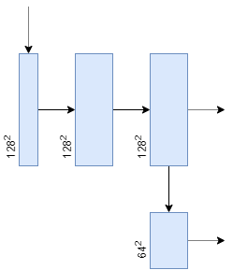
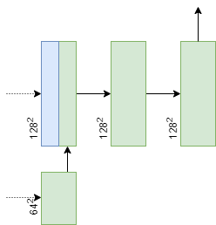
Models
Convolution unit
Fig 8. down sampling unit
Fig 9. down sampling unit

Slide 9
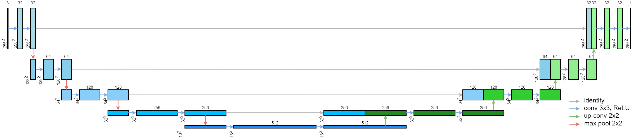
Models
UNet
Fig 10. UNet model structure.
Adapted from: [1] Ronneberger O., Fischer P., Brox T. (2015) U-Net: Convolutional Networks for Biomedical Image Segmentation.

Slide 10
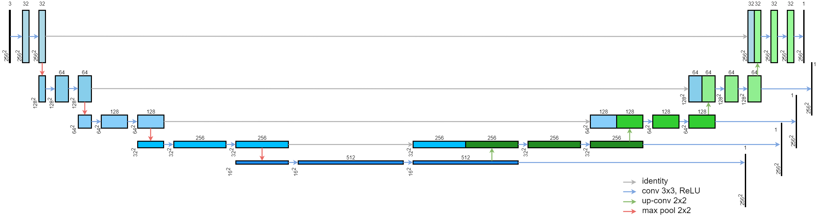
Models
Multi-Output UNet
Fig 11. Multi-OutputUNet model structure.
Idea from: [2] Sun, Tao, et al. ”Stacked U-Nets With Multi-Output for Road Extraction.” CVPR Workshops. 2018.

Slide 11
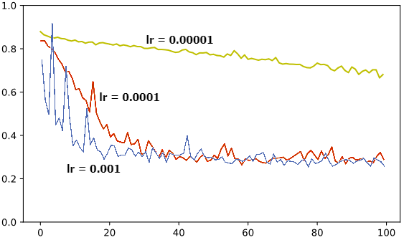
Models
Learning rate
Fig 12. Curve of loss with different learning rate

Slide 12
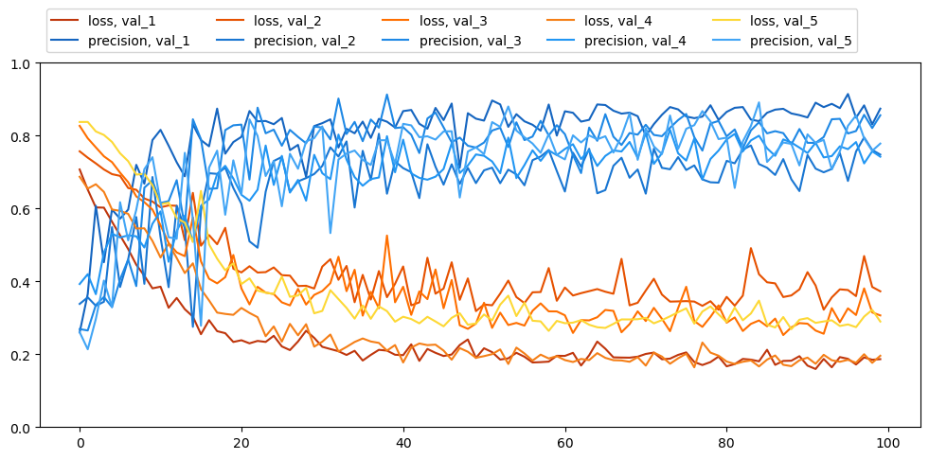
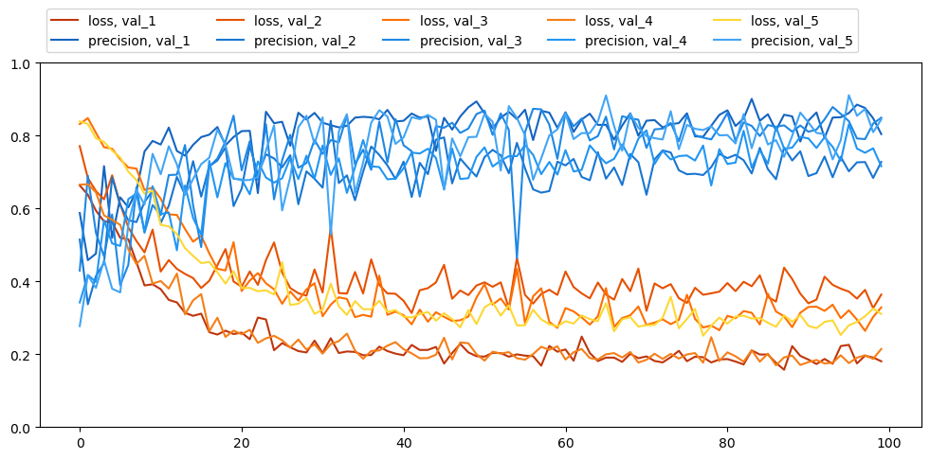
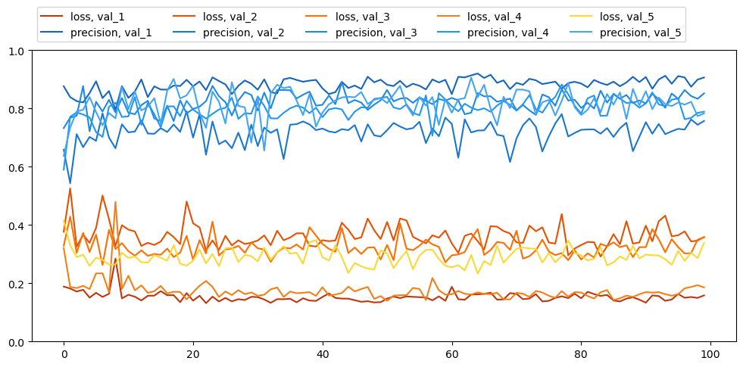
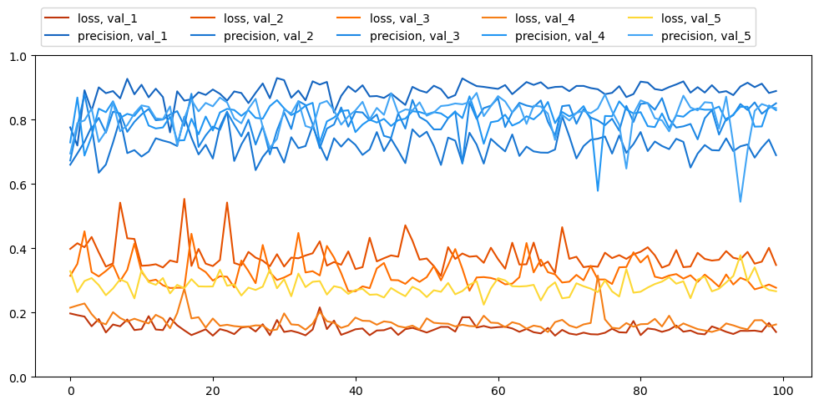
Results
Training curve
Fig. 13: Evaluation curve of UNet
Fig. 14: Evaluation curve of Multi-Output UNet
Fig. 15: Evaluation curve of FCN ResNet50
Fig. 16: Evaluation curve of DeepLabV3 ResNet50

Slide 13
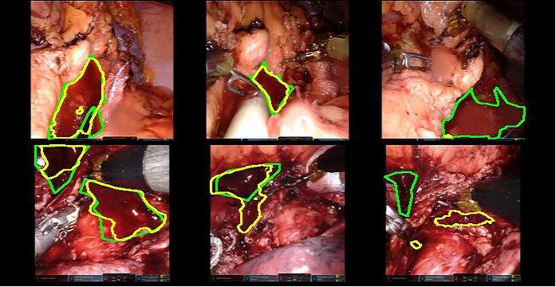
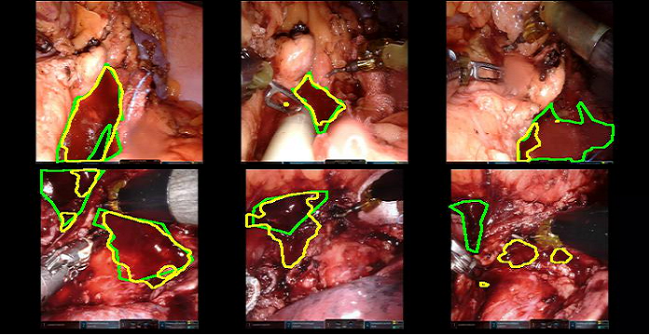

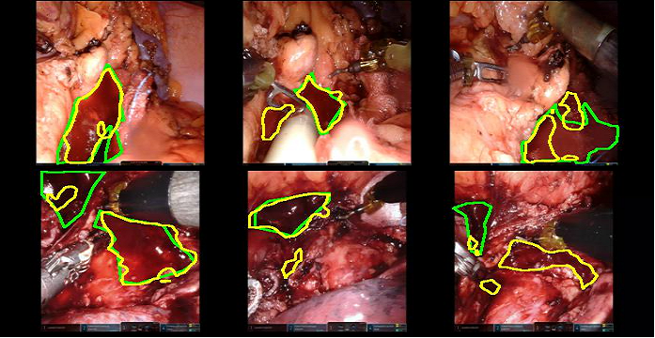
Results
Model estimations
Fig. 17: Evaluation curve of UNet
Fig. 18: Evaluation curve of Multi-Output UNet
Fig. 19: Evaluation curve of FCN ResNet50
Fig. 20: Evaluation curve of DeepLabV3 ResNet50

Slide 14
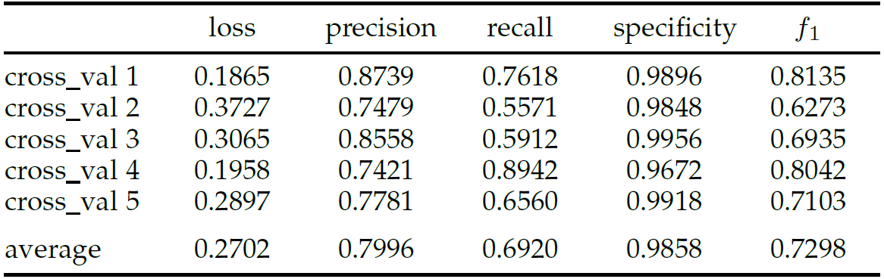
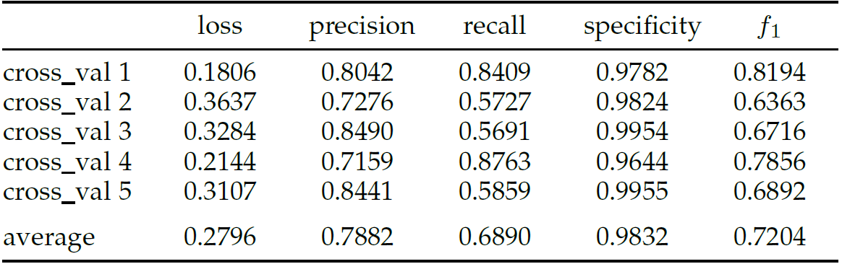
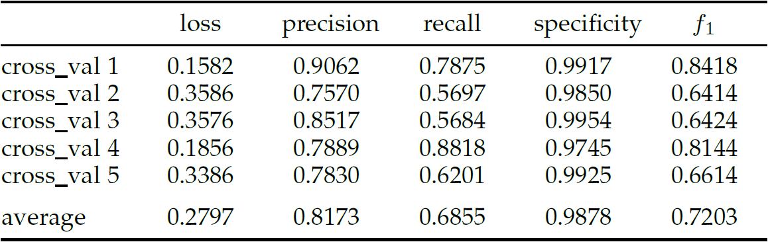
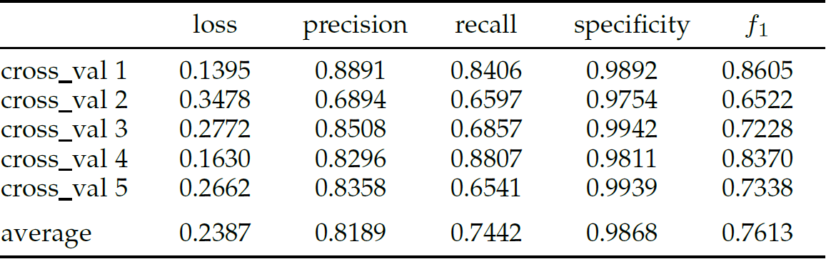
Results
Evaluation data and statistic
Fig. 21: Evaluation curve of UNet
Fig. 22: Evaluation curve of Multi-Output UNet
Fig. 23: Evaluation curve of FCN ResNet50
Fig. 24: Evaluation curve of DeepLabV3 ResNet50

Slide 15
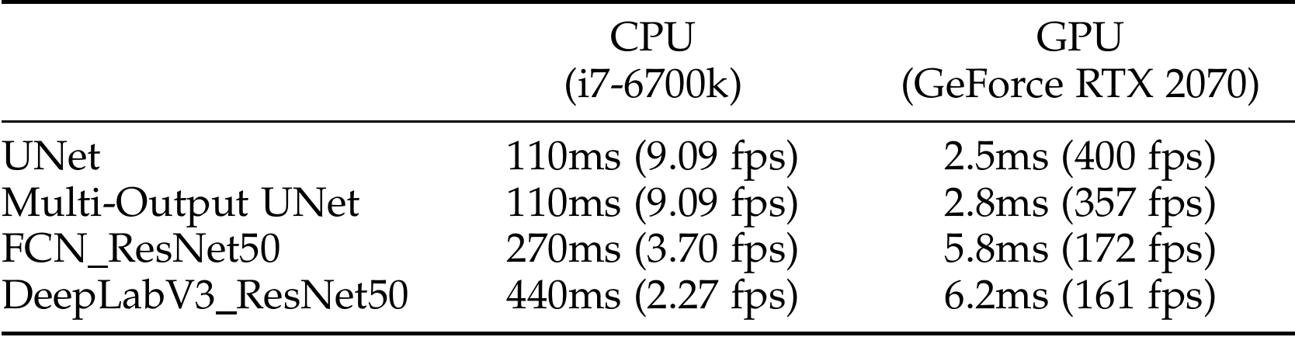
Results
Response time
Fig. 25: Response time of different model

Slide 16
Conclution
 | Loss | Stability | Response Time
UNet | medium | medium-low | short
Multi-Out UNet | medium | medium | short
FCN ResNet | medium | medium | long
DeepLab ResNet | medium | medium | long

Slide 17
Reference
[1] Ronneberger O., Fischer P., Brox T. (2015) U-Net: Convolutional Networks for Biomedical Image Segmentation.
[2] Sun, Tao, et al. ”Stacked U-Nets With Multi-Output for Road Extraction.” CVPR Workshops. 2018.

